Slide 1




Add-on Solution for Microsoft Dynamics365 Business Central
CETAS
VMP365
Notes:
CETAS Presents Vendor Portal for Microsoft Dynamics Solutions, CETAS, leading ISV and Gold Certified Microsoft Managed Partner and globally recognized Service provider of Microsoft Dynamics Offerings.
CETAS Vendor Portal, designed exclusively for Microsoft Dynamics 365 Business Central to address the Growing mid-market companies concerns on the supplier adoption, Procure to pay visibility and Vendor Collaborations.

Slide 2


Why Vendor Management Portal 365
Lead time & Delay
Invoice/Payment Mismatch
RFQ, Quote, Comparisons
Manual Process
Communications
Data Duplications
Procure to Pay Visibility
Data silos & Lack of Visibility
PO Release,
Acknowledgement
SoA/ Reconciliations
Supplier queries
Order, Payment Status
Vendor On-Boarding
& Data Accuracy
Change orders
ERP Updates & Duplications
Notes:
As per the recent reports and in our conversation with growing Mid market enterprises on
Amount of manual work do they routinely do?
Efforts goes in double data entry is required for RFQ Process or acknowledge the order or enter the Order in ERP,
Efforts in data duplication to converting the orders from email, phone, fax to ERP system,
Time spent answering questions from vendors for AP, Payments, approvals or account statement or even for Vendor On Boarding to get the compliance data like VAT details
Therefore, 10% of a companies’ operating revenue is spent on establishing Supplier & Procurement team relationship and managing the communications challenges, and top most concerns on the productivity, efficiency and accuracy of data.
To accomplish this, many mid size organizations are looking to automate these process and bring real time visibility into Procure to Pay Process and collaborations with procurement team and vendors.

Slide 3
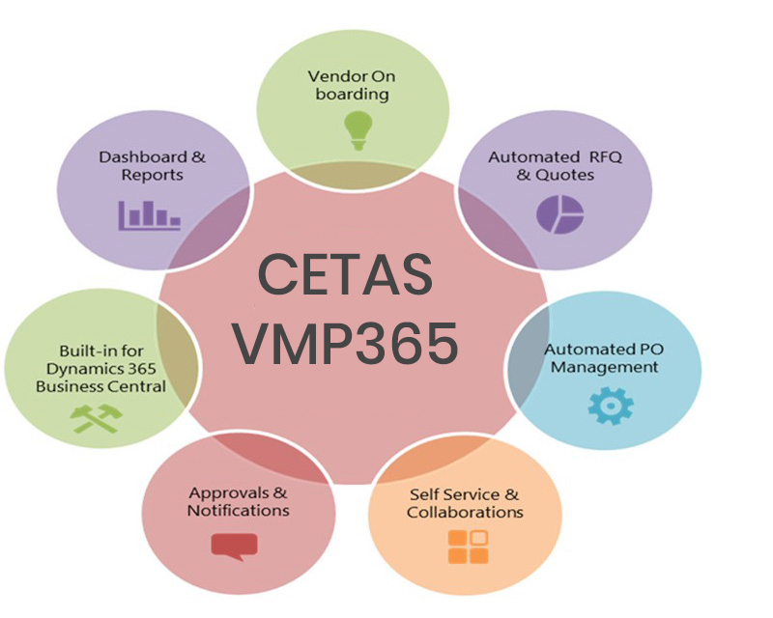
CETAS VMP365
CETAS VMP365 is an add-on solution designed to help Microsoft Dynamics 365 Business Central customers to automate the Procure to pay visibility and self-Service Portal solutions to boost supplier relationship, Streamline the Process and collaboration with an easy to use, flexible, seamlessly integrated and highly secured Solutions.
Notes:
CETAS Vendor Portal is add-on solutions designed to help Dynamics 365 Business Central customers to automates the Procure to pay visibility and self-Service Portal solutions to boost supplier relationships and collaboration.
Powered by CETAS CHAMP Framework, the tightly integrated solution enhances the capabilities of Dynamics 365 Business Central by allowing the vendor to actively participate with an intuitive and dynamic portal while you speedup processing, reduce back office efforts, cut costs and improves accuracy of business transactions with vendors and build a more engaging business relationship.
Some of the CETAS Vendor Portal core functionality are Vendor On-boarding, Automated RFQ & Quote Management, Quote Comparisons with Multiple Technical parameters and terms, Automated PO Management, Invoice & Payment Matching, Supplier Self Service & Collaborations and built in Reports & Dashboards

Slide 4
Process Flow
Vendor Registration (Portal)
Release RFQ (Dynamics 365 Business Central)
Prepare Quote (Portal)
Release PO (Dynamics 365 Business Central)
Ship Goods & Send Invoice (outside system)
View Invoice (Portal)
Make Payment (Dynamics 365 Business Central)
Statement of Accounts (Portal)
Approve Registration (Dynamics 365 Business Central)
Legend
Portal
Dynamics 365 Business Central
External

Slide 5
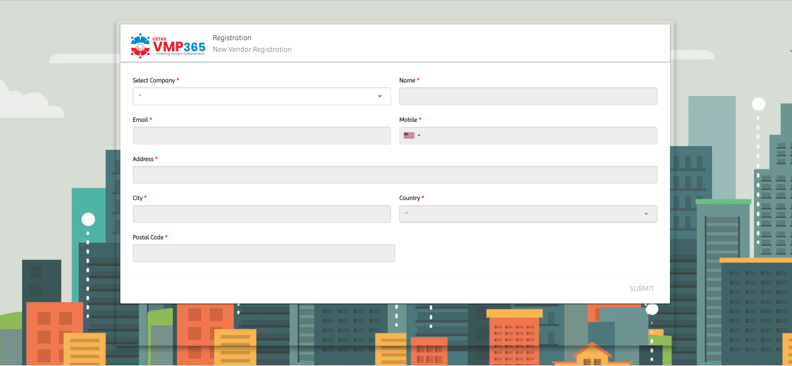
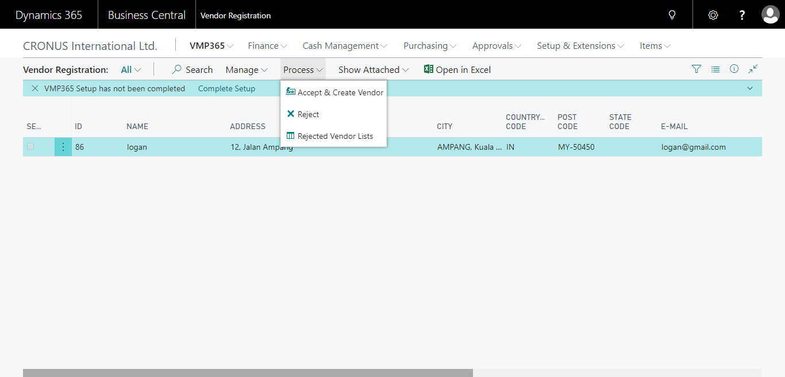
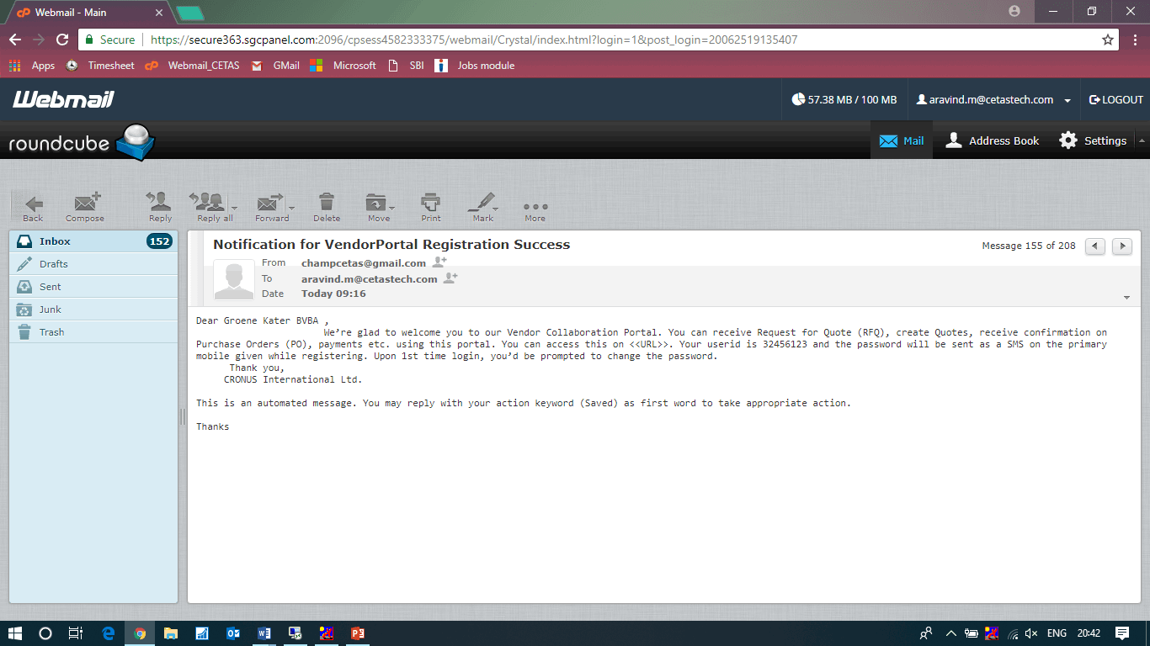
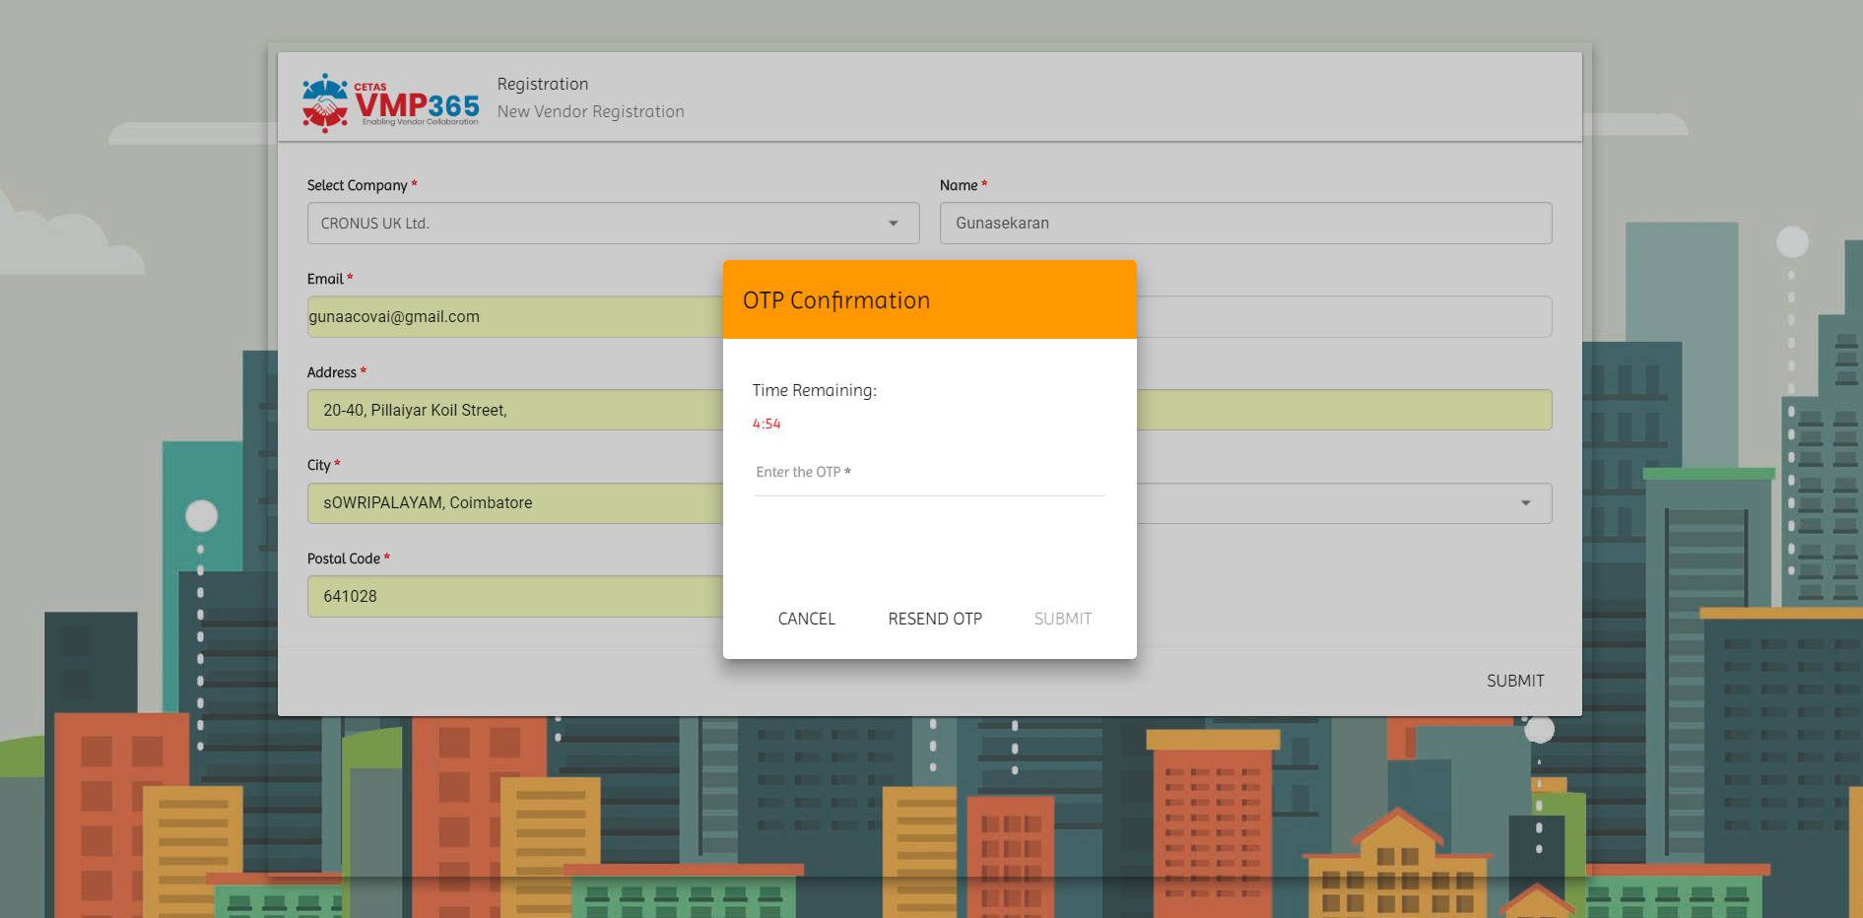
Solution Screenshots – Vendor-Onboarding

Slide 6
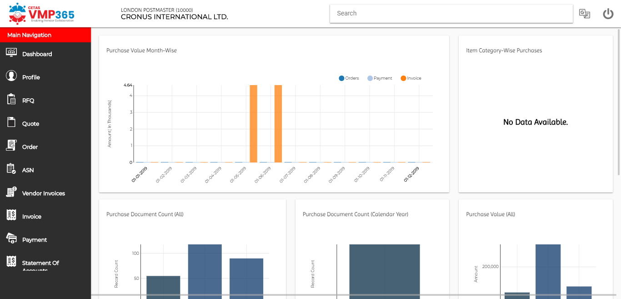
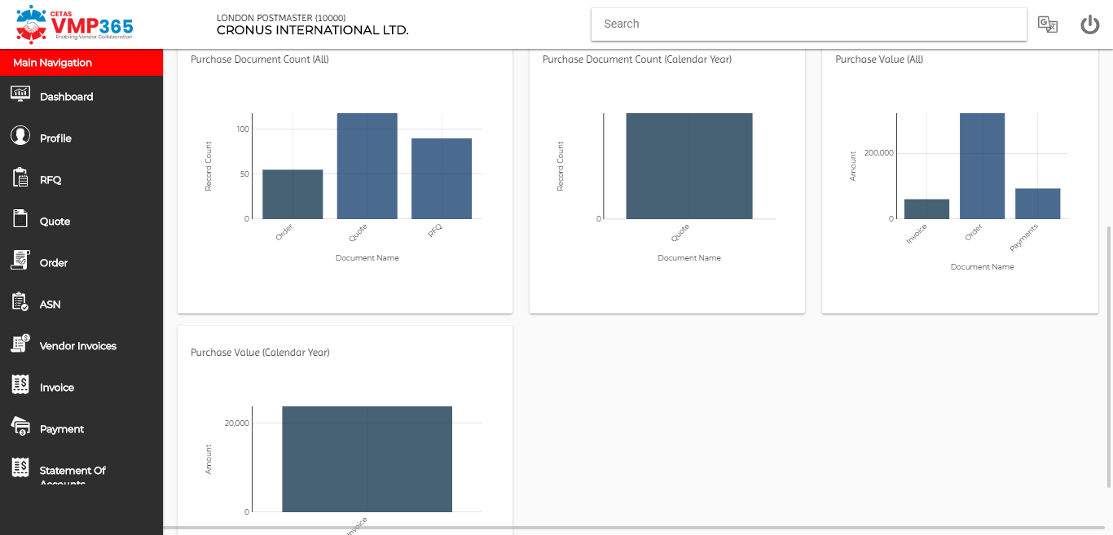
Solution Screenshots – Dashboards

Slide 7
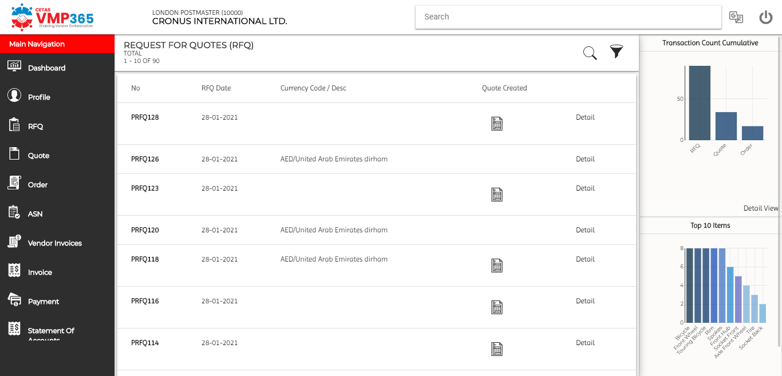
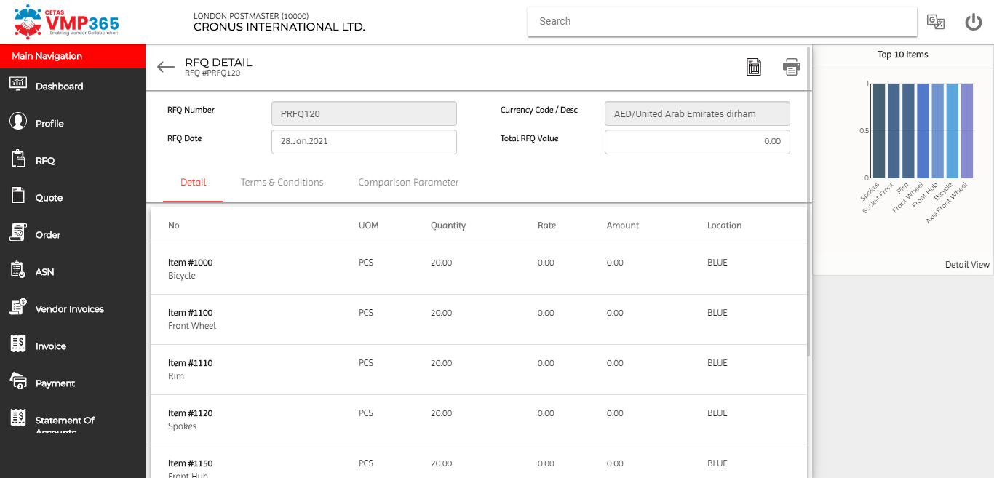
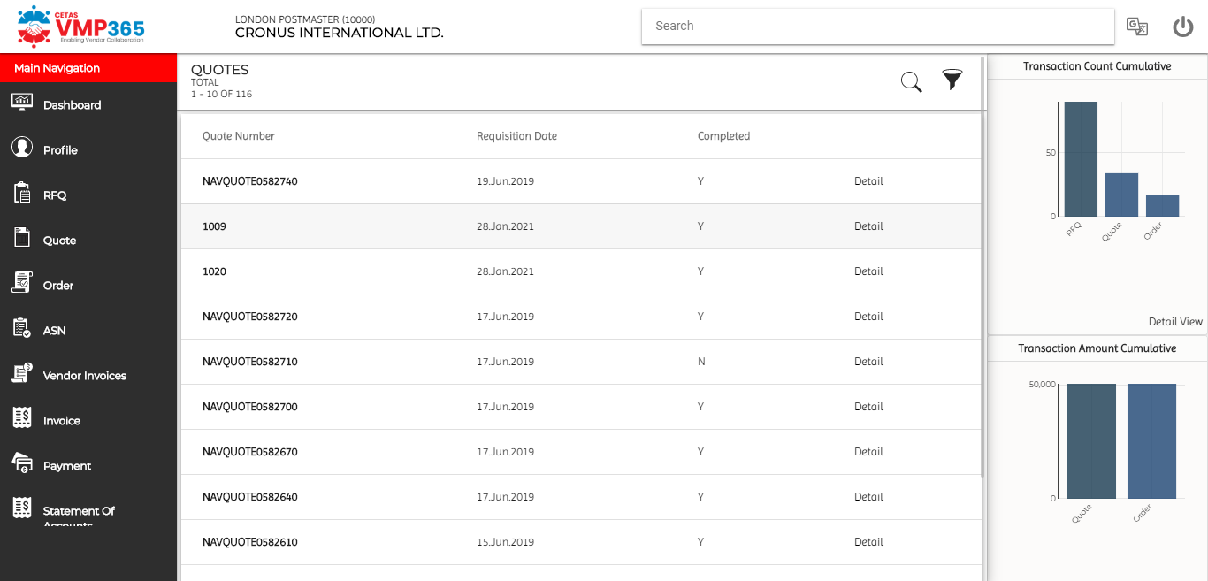
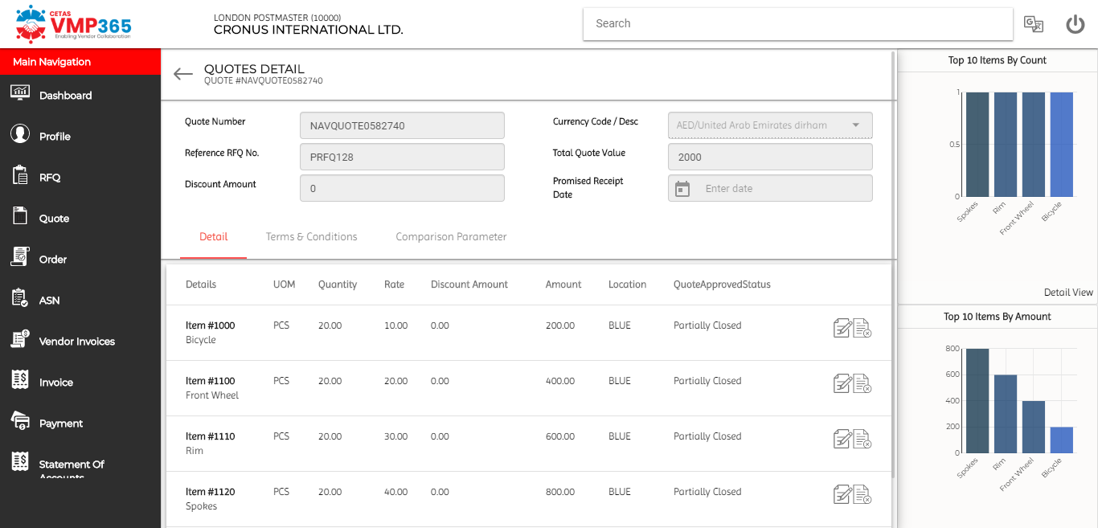
Solution Screenshots – RFQ & Quote Management

Slide 8
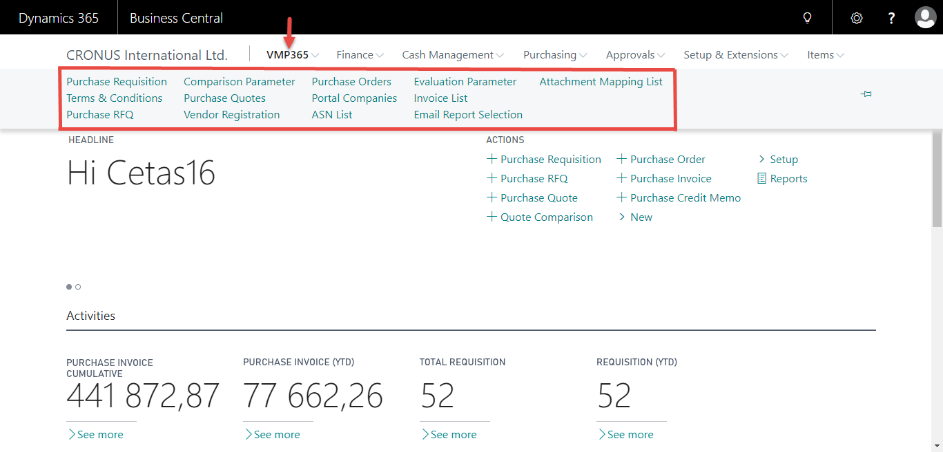
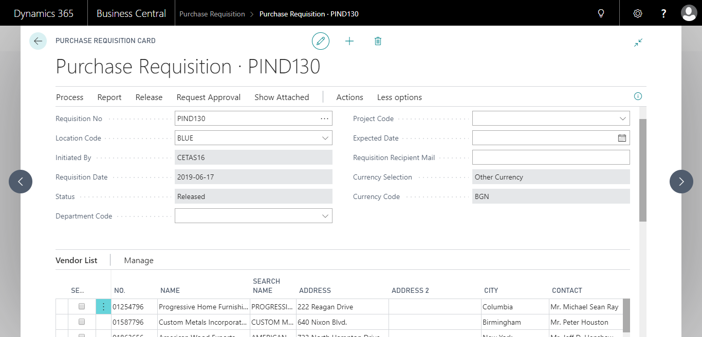
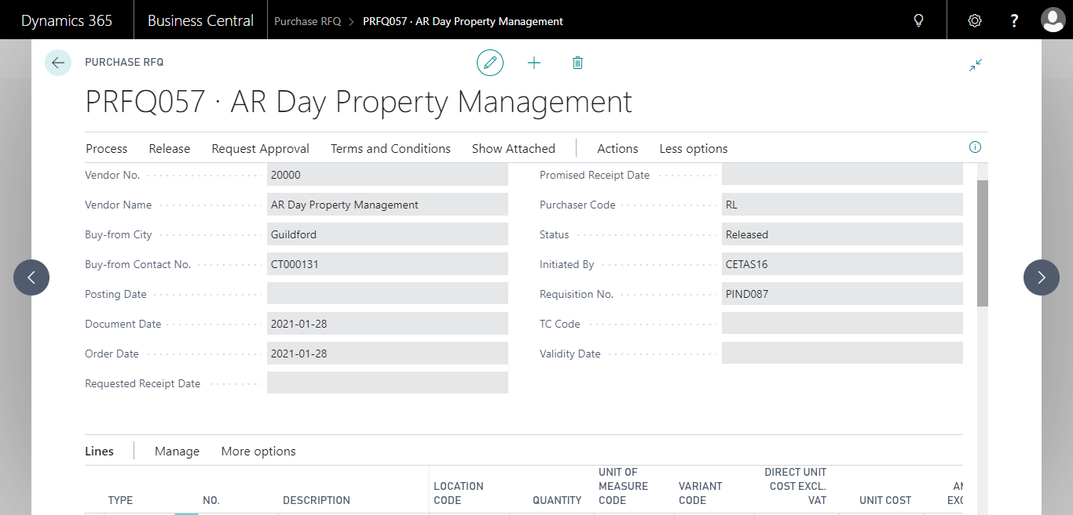
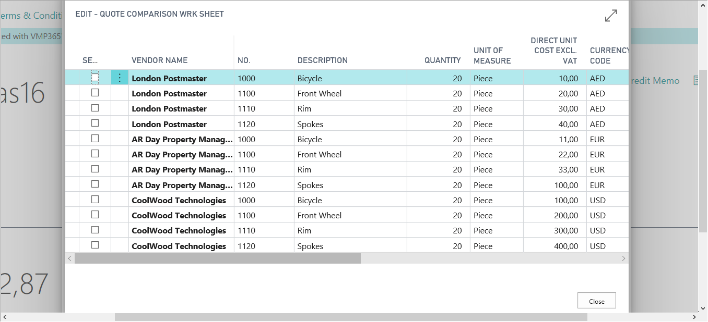
Solution Screenshots – Enhancements in Dynamics 365 Business Central

Slide 9
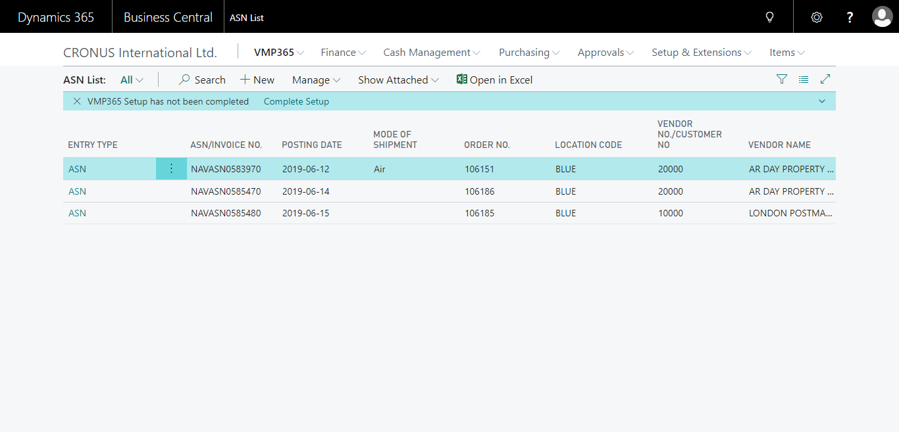
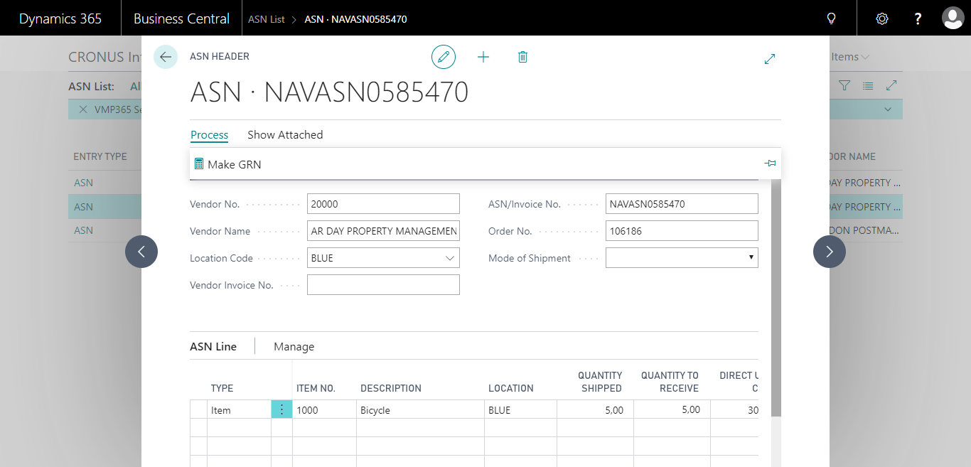
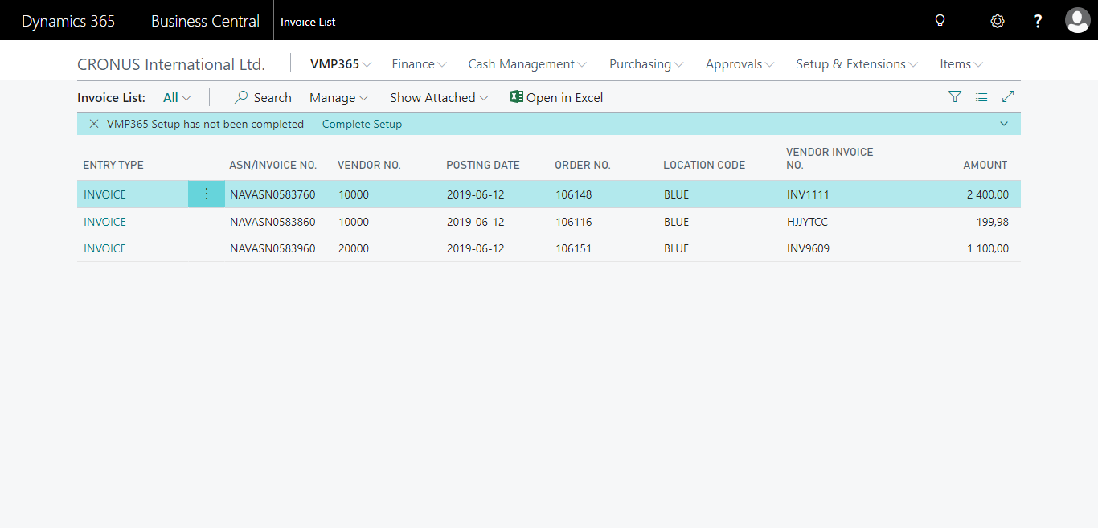
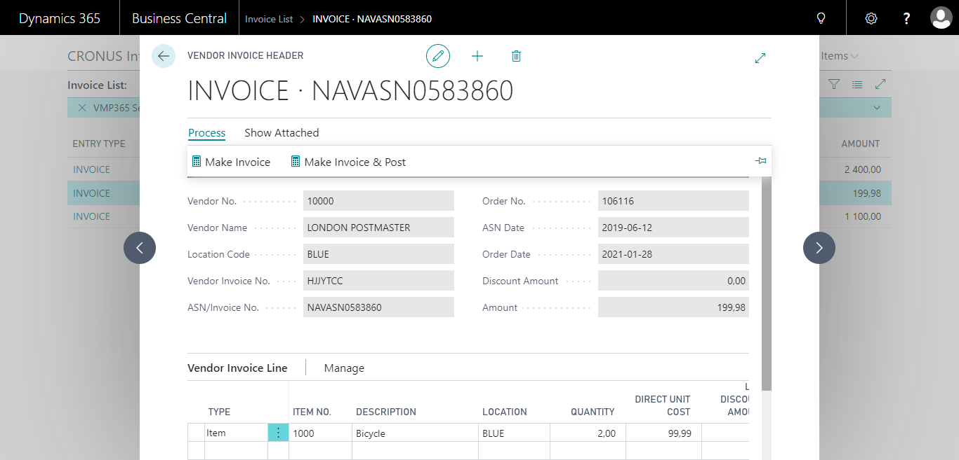
Solution Screenshot- ASN List & Invoice list

Slide 10
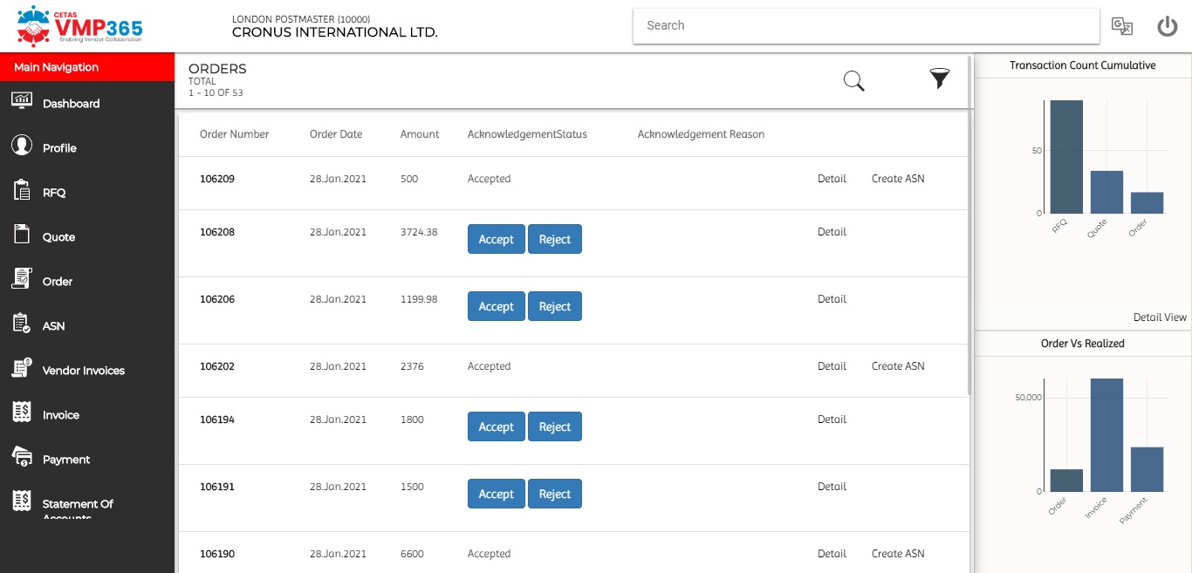
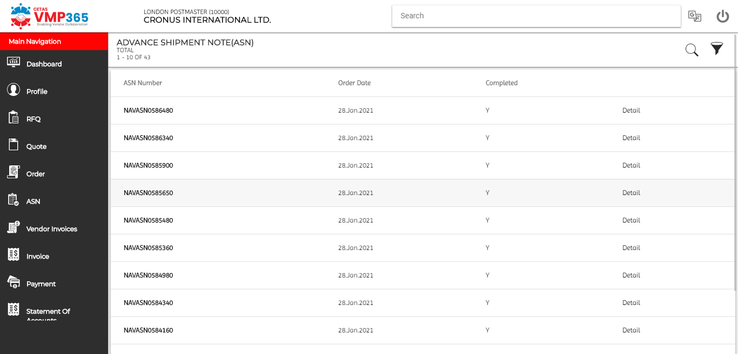
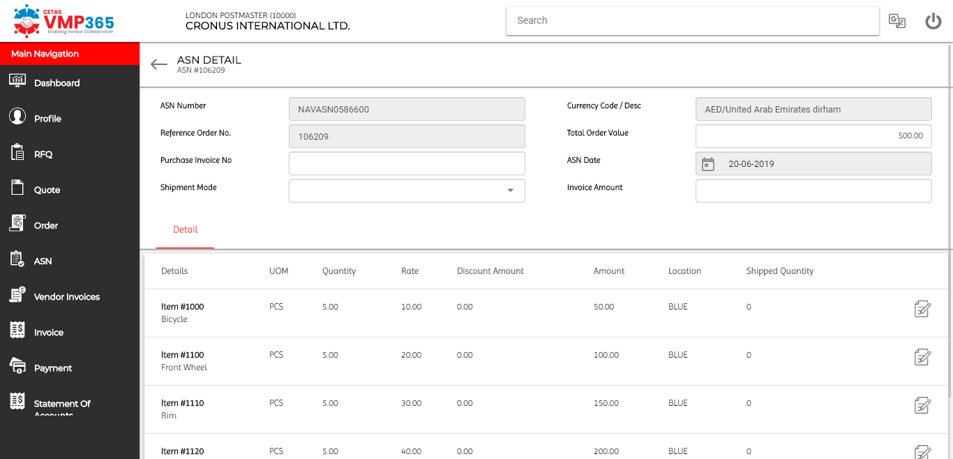
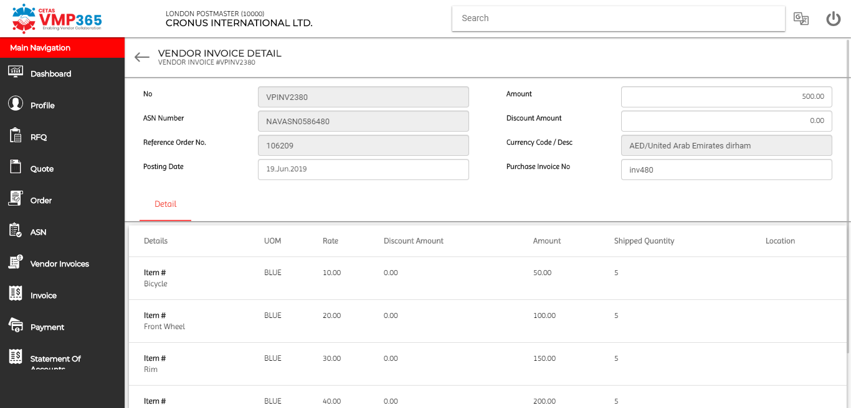
Solution Screenshot- Order & ASN management

Slide 11
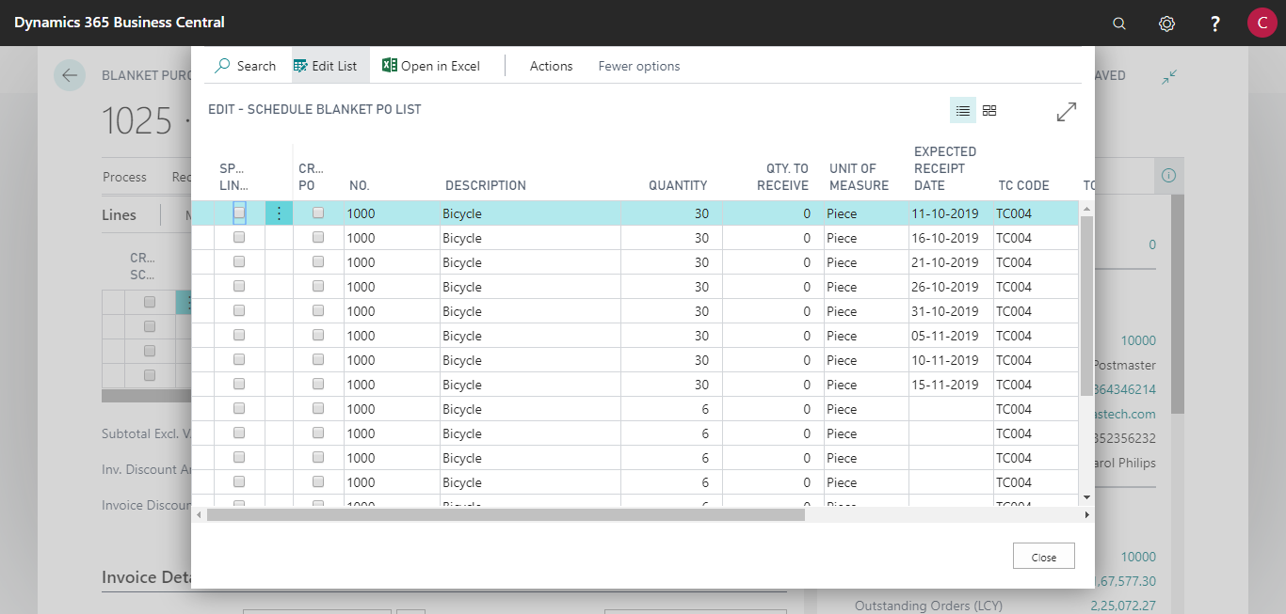
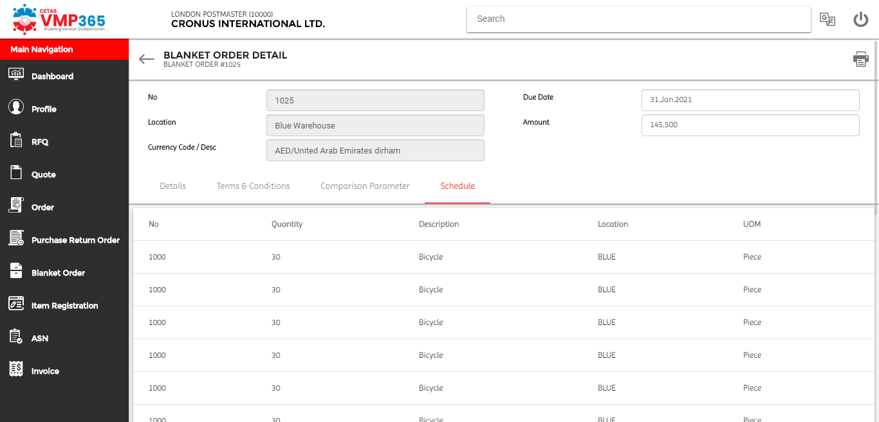
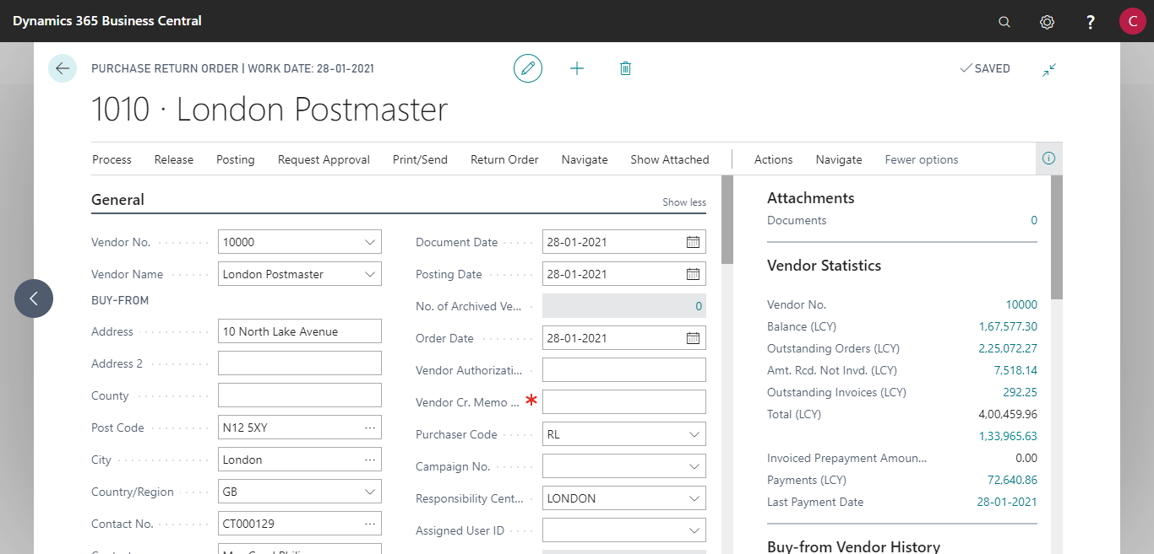
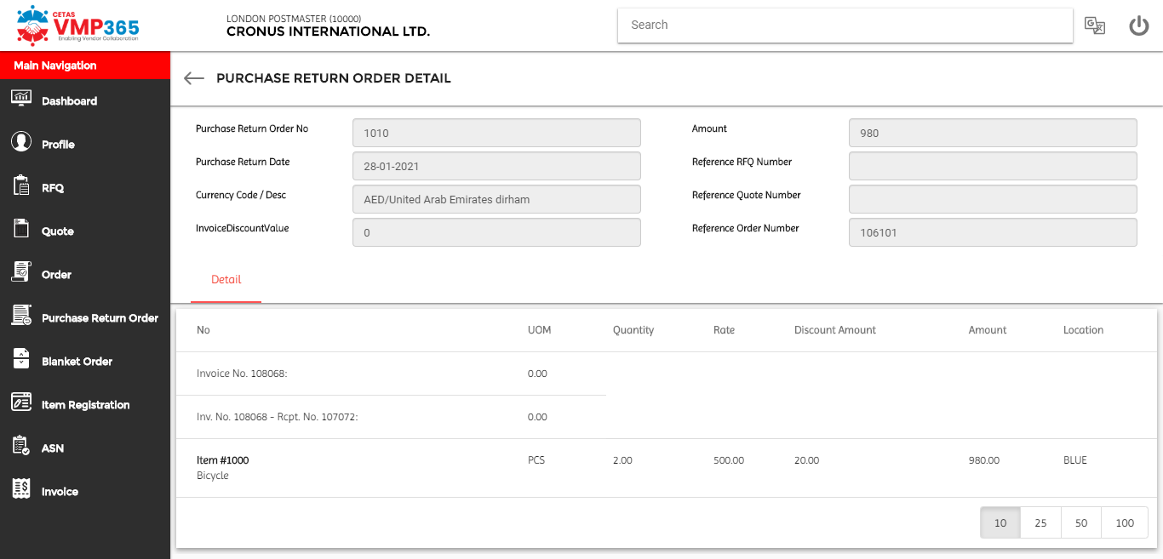
Solution Screenshot- Blanket order & Purchase Return Order

Slide 12
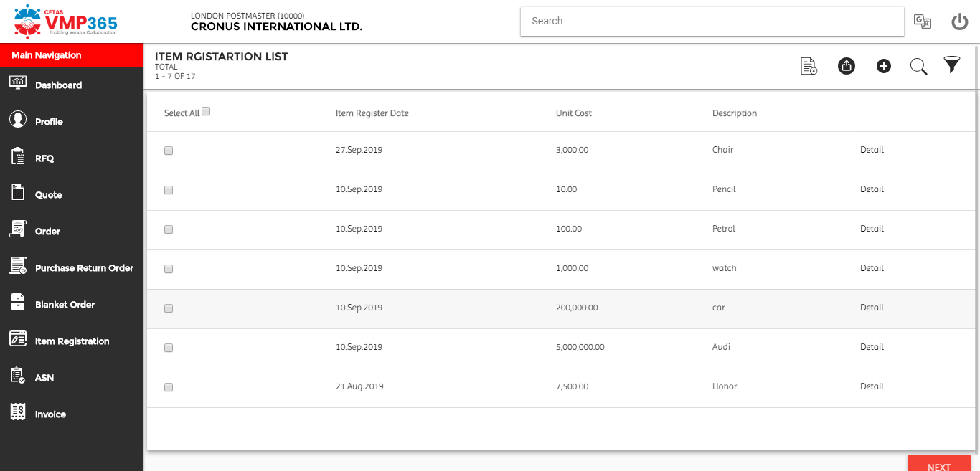
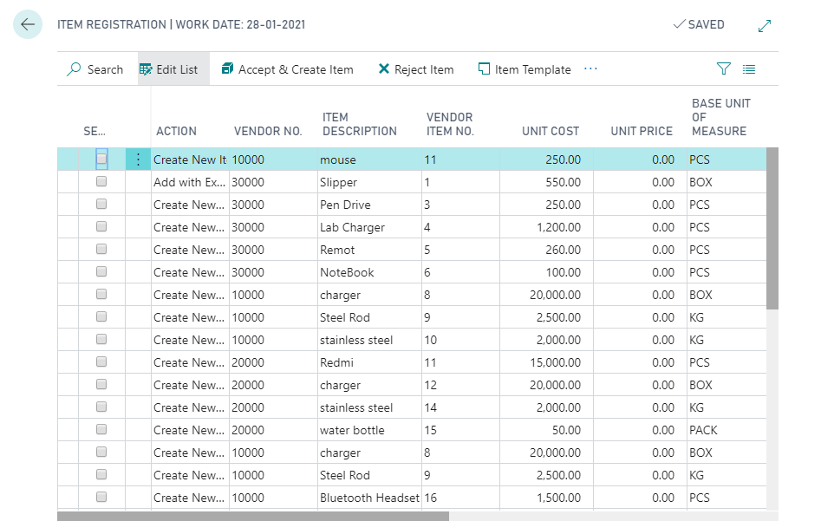
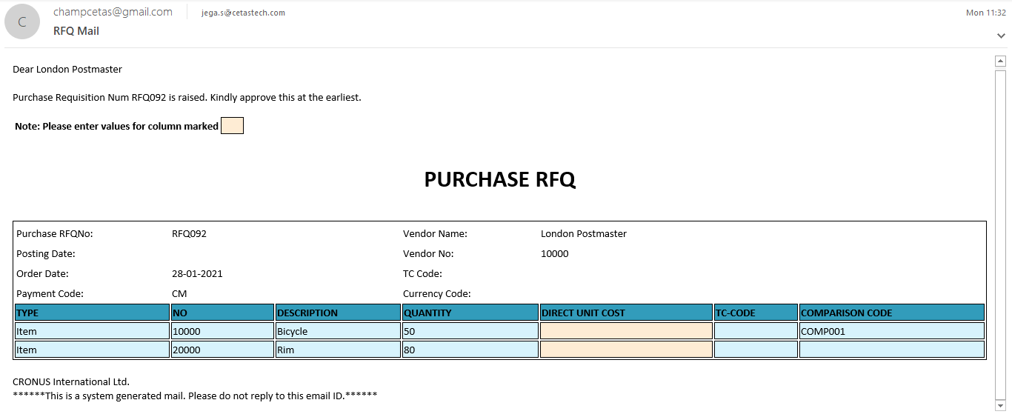
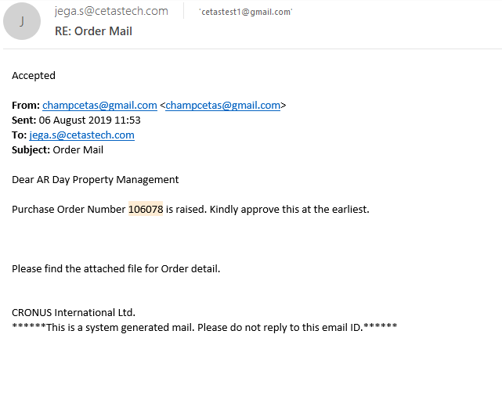
Solution Screenshot- Item Registration & Mail Parsing

Slide 13
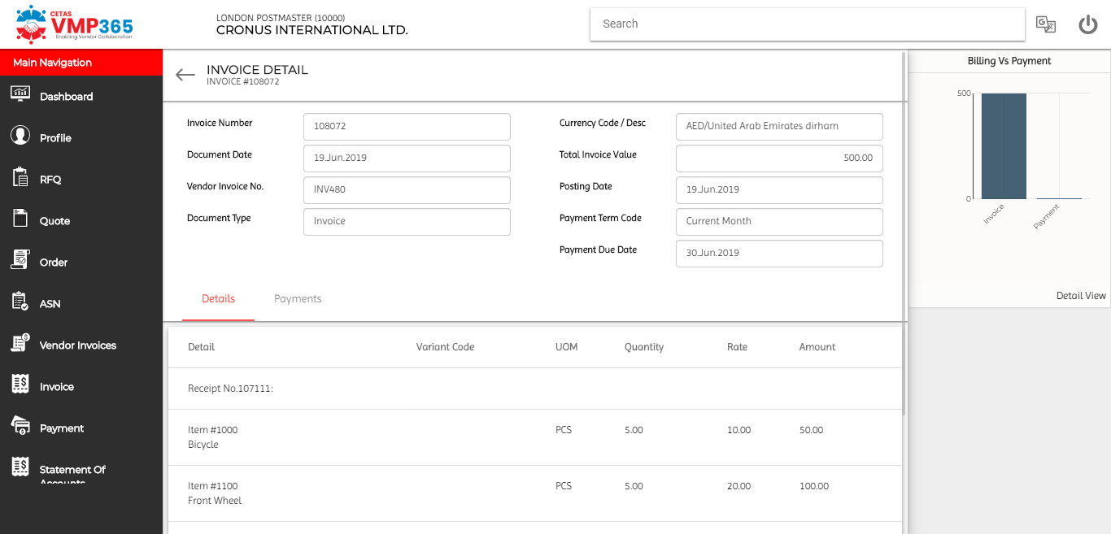
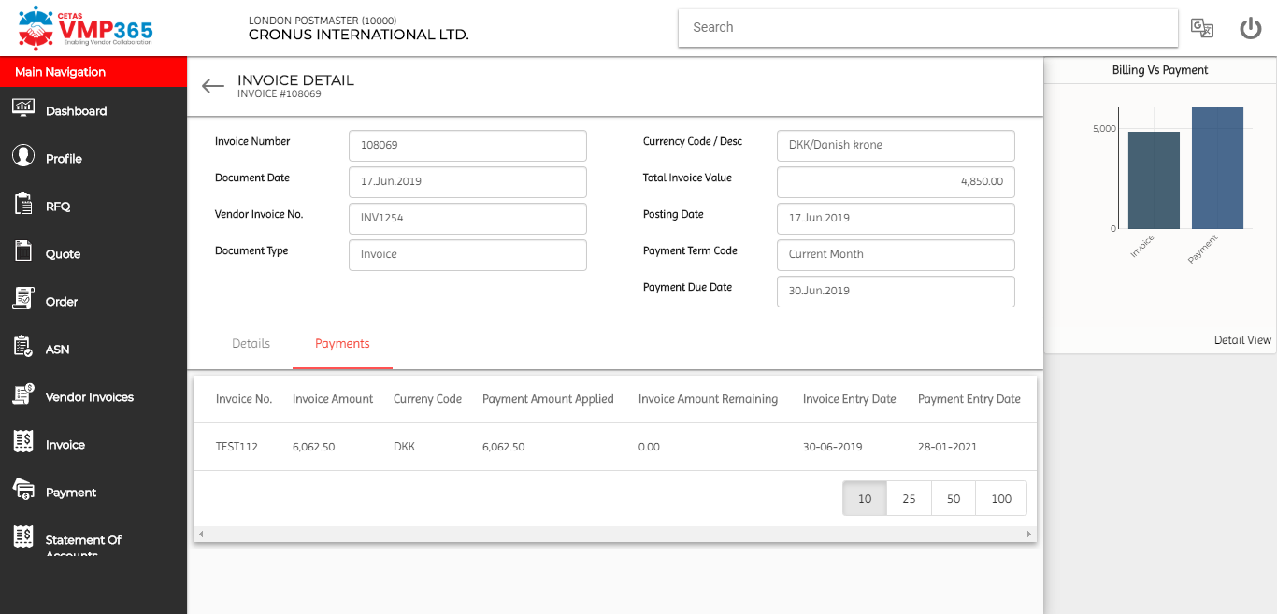
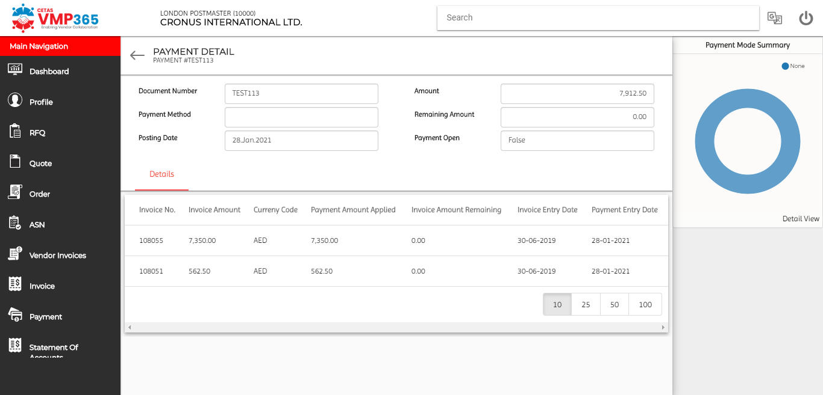
Solution Screenshots – Invoice & Payment View

Slide 14
CETAS VMP365 Benefits
      Simply the Process & Improved Information Access
      Fully integrated and automated Self Service Portal with Dynamics 365 Business Central establishes process standards, eliminates all manual data entry, reduce operational costs and governance to Maximize vendor adoption
      Collaborative Relationship with Vendors
      Portals provide both supplier and buyer a single, shared unified data streams to reduce errors, inquiries and faster issue resolutions and improve productivity leads to huge cost savings
      Streamline the Supplier Management and Communications
      Reduce your procurement team’s workload with a robust, scalable, self-service portal and enforce workflow & approvals to keeps processes on track, automates time-consuming manual tasks and keeps players informed and involved.
      Real Time Insights leads operational efficiency
      Gain full visibility into the status, transactions, documents, Approvals and notifications at-a-glance insights with built-in supplier metrics to make informed and timely decisions
Notes:
Both you and your vendors will enjoy the many benefits of onboarding using your self-serve supplier/vendor portal. Just some of these advantages include:
More accurate data entry
Enhanced vendor and Procurement features in NAV and Dynamics 365 Business central
No duplicate entries or redundancies
High visibility in Procure to Pay process
Collect vendor master data once, update when needed
Suppliers can access their secure self-serve portal anytime, anywhere
Transparency in payment and order processing

Slide 15
CETAS VMP365 Availability
Available Versions | Remarks
Dynamics NAV2016 | Buyer Workspace available in perpetual model only; Portal can be hosted in customer’s infra on perpetual model or on our azure infra on SaaS model.
Dynamics NAV2017 | Same as above
Dynamics NAV2018 | Same as above
Dynamics 365 Business Central | For cloud deployments only SaaS pricing model applicable; For On-Prem, pricing models available for NAV is applicable here as well.
Notes:
Both you and your vendors will enjoy the many benefits of onboarding using your self-serve supplier/vendor portal. Just some of these advantages include:
More accurate data entry
Enhanced vendor and Procurement features in NAV and Dynamics 365 Business central
No duplicate entries or redundancies
High visibility in Procure to Pay process
Collect vendor master data once, update when needed
Suppliers can access their secure self-serve portal anytime, anywhere
Transparency in payment and order processing

Slide 16
CETAS VMP365 SaaS Pricing
Pricing Element | Price in USD | Remarks
Dynamics 365 Business Central app | 2 US$ per user per month | Applies to all users in the Dynamics 365 Business Central tenant
Self Service Portal | 200US$ per month | For up to 500 vendors
VMP365 portal is hosted in Azure
The price above includes hardware, database etc.
For instances of having more vendors, pls contact sales@cetastech.com for enterprise pricing
A customer can only use the enhancements (like requisition, Quote comparison, vendor evaluation etc) within Dynamics 365 Business Central alone, without the self-service portal.
Any training or customization requests are chargeable separately.
Notes:
Both you and your vendors will enjoy the many benefits of onboarding using your self-serve supplier/vendor portal. Just some of these advantages include:
More accurate data entry
Enhanced vendor and Procurement features in NAV and Dynamics 365 Business central
No duplicate entries or redundancies
High visibility in Procure to Pay process
Collect vendor master data once, update when needed
Suppliers can access their secure self-serve portal anytime, anywhere
Transparency in payment and order processing

Slide 17
CETAS VMP365 Perpetual Pricing
Pricing Element | Price in USD | Remarks
Dynamics NAV – Buyer Workspace | 2,000US$ | Annual Renewal Fee @ 20%
Self Service Portal | 7,000US$ | Annual Renewal Fee @ 20%
VMP365 portal will be hosted in any environment of Customers’ choice
The price above includes does not include hardware, database etc.
No limit on number of vendors
A customer can only use the Buyer Workspace (enhancements like requisition, Quote comparison, vendor evaluation etc) within Dynamics NAV alone, without the self-service portal.
Any training or customization requests are chargeable separately.
Notes:
Both you and your vendors will enjoy the many benefits of onboarding using your self-serve supplier/vendor portal. Just some of these advantages include:
More accurate data entry
Enhanced vendor and Procurement features in NAV and Dynamics 365 Business central
No duplicate entries or redundancies
High visibility in Procure to Pay process
Collect vendor master data once, update when needed
Suppliers can access their secure self-serve portal anytime, anywhere
Transparency in payment and order processing

Slide 18
Thank You
Look forward to work with you
Pls write to us if you have any queries
sales@cetastech.com
www.cetastech.com
Notes:
Thanks for watching, and interested to know more and for a demo, Please write to us

